Slide 1
Spearman Rank Correlation Example
A researcher wishes to assess whether
the distance to general practice
influences the time of diagnosis of
colorectal cancer.
The null hypothesis would be that
distance is not associated with time to
diagnosis. Data collected for 7 patients

Slide 2
Distance from GP and time to diagnosis
Distance (km) | Time to diagnosis (weeks)
5 | 6
2 | 4
4 | 3
8 | 4
20 | 5
45 | 5
10 | 4

Slide 3
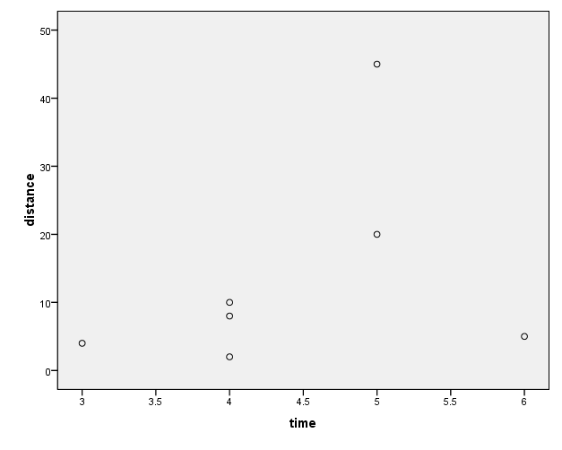
Scatterplot

Slide 4
Distance from GP and time to diagnosis
Distance (km) | Time (weeks) | Rank for distance | Rank for time | Difference in Ranks | D²
2 | 4 | 1 | 3 | -2 | 4
4 | 3 | 2 | 1 | 1 | 1
5 | 6 | 3 | 7 | -4 | 16
8 | 4 | 4 | 3 | 1 | 1
10 | 4 | 5 | 3 | 2 | 4
20 | 5 | 6 | 5.5 | 0.5 | 0.25
45 | 5 | 7 | 5.5 | 1.5 | 2.25
 |  |  |  | Total = 0 | ∑d²=28.5

Slide 5

Spearman Rank Correlation
Provides a measure o correlation between ranks
The formula for Spearman’s rank
correlation is (approximation):
where n is the number of pairs

Slide 6
Spearman Rank Correlation Example
In our example, r_{s}=0.468
6*28/(7*(7-1))
In R we can see that this value is not significant, ie.p=0.29
Therefore there is no significant
relationship between the distance to a
GP and the time to diagnosis but note that correlation is quite high!

Slide 7
Spearman Rank Correlation
Correlations lie between –1 to +1
A correlation coefficient close to zero indicates weak or no correlation
P-Value indicate statistical significance of observed correlation
Correlation does NOT measure causality only association
It assesses how well the relationship between two variables can be described using a monotonic function (whether linear or not)

Slide 8
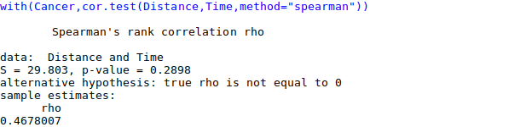
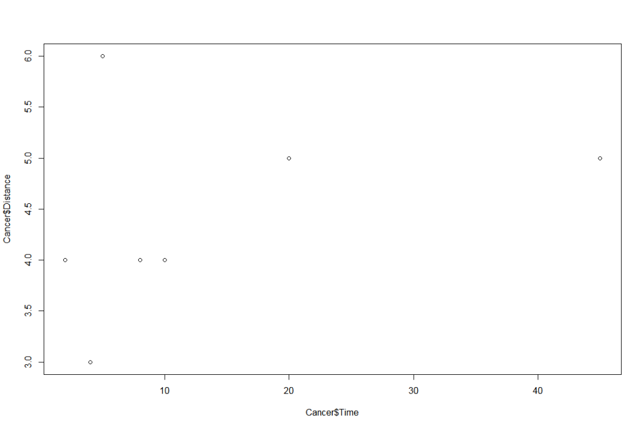

Slide 9
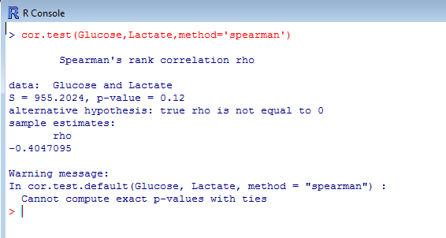
Spearman’s Correlation in R

